Slide 1
Retention Update Andy Morris September 27, 2018

Slide 2
Transfer Retention

Slide 3
Freshman Retention

Slide 4
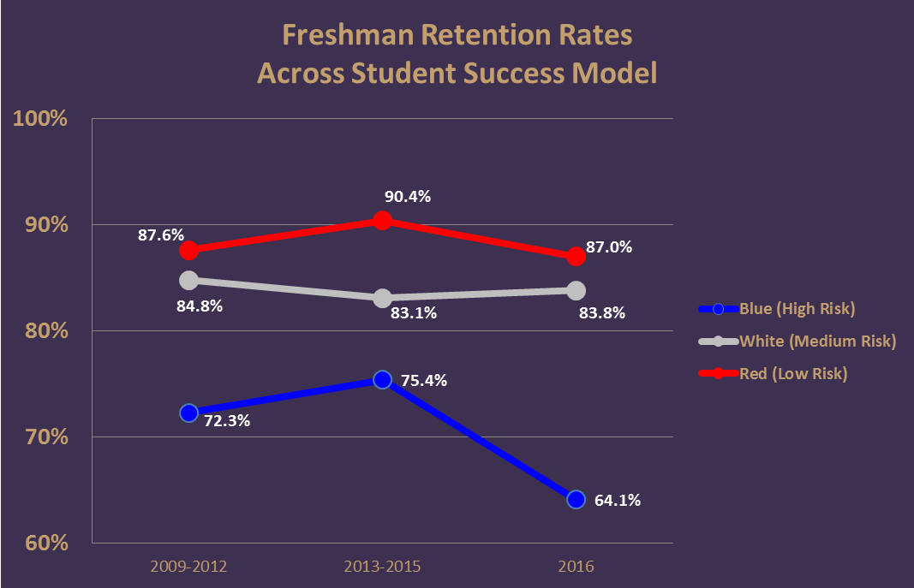
Data – Student Success Model

Slide 5
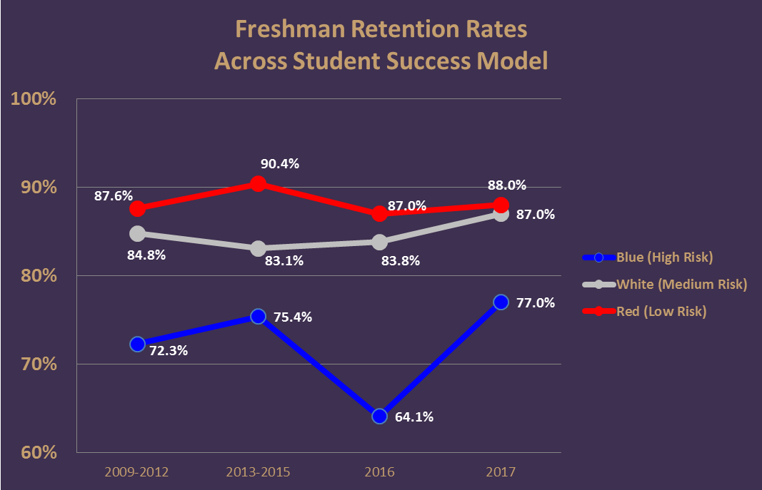

Slide 6
Focus on Progress Towards Degree
“15 to Finish” Campaign
“Finish in Four” summer program

