Slide 1
Asexuality
An Introduction

Slide 2
What is Asexuality?
Asexual: a person who does not experience sexual attraction.
Asexuality: a sexual orientation describing people who do not experience sexual attraction.
Ace: a nickname for an asexual person.

Slide 3
The Kinsey Scale
Rating | Description
0 | Exclusively heterosexual
1 | Predominantly heterosexual, only incidentally homosexual
2 | Predominantly heterosexual, but more than incidentally homosexual
3 | Equally heterosexual and homosexual (bisexual)
4 | Predominantly homosexual, but more than incidentally heterosexual
5 | Predominantly homosexual, only incidentally heterosexual
6 | Exclusively homosexual
X | Asexual
Alfred Kinsey, 1948

Slide 4
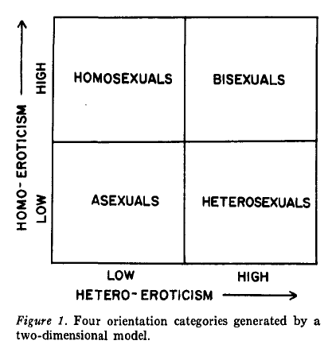
The Storms Model
Two-dimensional map of erotic orientation
Four sexual orientation categories
Includes Asexuality
Michael Storms, 1980

Slide 5
Who Are Asexuals?
1% of the population is estimated to be Asexual
There is a lot of diversity among Asexuals
  Romantic orientation
  Gender identity
  Attitude towards sex
Little scientific research has been done about Asexuality

Slide 6

The Asexual Visibility and Education Network
AVEN – The Asexual Visibility and Education Network
  Founded in 2001 by David Jay
  World’s largest Asexual community
  Over 28,000 members
  Asexuality.org
AVEN logo

Slide 7
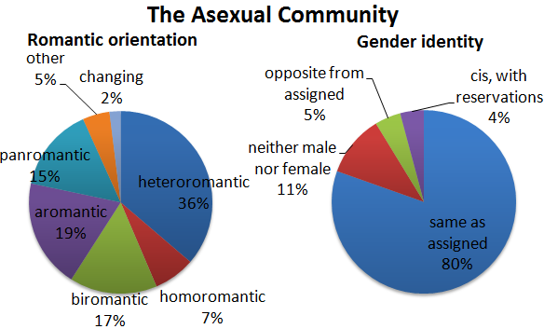
The AVEN Community
The demographics of the Asexual Community at AVEN are based on two internet surveys conducted on AVEN.

Slide 8
Attraction
A mental or emotional force that draws people together.

Slide 9
Sexual Attraction
A feeling sexual people get that causes them to desire sexual contact with a specific other person.
  Often mixed with another form of attraction
  Involves a desire for the sexual act itself
  Not the same thing as a sex drive or libido
    Sex drive (libido): a desire for sexual contact

Slide 10
Romantic Attraction
A feeling that causes people to desire a romantic relationship with a specific other person.
  Crush: a romantic attraction to someone
  Squish: an aromantic crush; a desire for a platonic relationship with someone
Can occur independently of or alongside other types of attraction.

Slide 11
Aesthetic Attraction
An attraction to other people that is not connected to a desire to do anything with them, either sexually or romantically.
As with sexual and romantic attraction, aesthetic attraction can occur independently or simultaneously with other types of attraction.

Slide 12
Romantic Orientation
An individual’s pattern of romantic attraction to men, women, neither gender, either gender, or another gender.

Slide 13
Romantic Orientation
Romantic Asexuals
Aromantic Asexuals
Experience romantic attraction
Desire to form romantic relationships with others
Experience little or no romantic attraction
Do not desire to form romantic relationships with others

Slide 14
Romantic Orientation
Hetero-romantic: romantically attracted to a member of the opposite sex
Homo-romantic: romantically attracted to a member of the same sex

Slide 15
Romantic Orientation
Bi-romantic: romantically attracted to members of both sexes
Pan-romantic: romantically attracted to others but is not limited by the other’s sex or gender
  Goes beyond the gender binary to include transgender
Gray-romantic: a person with a romantic orientation that is somewhere between aromantic and romantic

Slide 16
Relationships
Romantic Asexuals
  Can form romantic relationships with either other asexuals or with sexuals
Aromantic Asexuals
  Generally do not form romantic relationships
  Often form close friendships that function as their primary relationships
  Do not lack emotional needs; their emotional needs can be fulfilled in a platonic way

Slide 17
The Gray Area

Slide 18
Gray-A
Some individuals identify in the gray area between Asexuality and sexuality
People who identify as gray-A can include, but are not limited to, those who:
  do not normally experience sexual attraction, but do experience it sometimes
  experience sexual attraction, but a low sex drive
  are technically sexual, but feel that it's not an important part of their lives and don't identify with standard sexual culture
  experience sexual attraction and drive, but not strongly enough to want to act on them

Slide 19
Gray-A
Some individuals identify in the gray area between Asexuality and sexuality
People who identify as gray-A can include, but are not limited to, those who:
  are functionally asexual and experience sexual feelings but do not engage in them
  people who can enjoy and desire sex, but only under very limited and specific circumstances
  people who experience some parts of sexuality but not others, according to the Primary vs. Secondary Sexual Attraction Model

Slide 20
Primary vs. Secondary Sexual Attraction Model
In this model, asexuals are people who lack primary sexual desire.
Some asexuals therefore experience attraction and/or secondary sexual desire, while others do not.
Most sexuals in romantic relationships feel both primary and secondary sexual desire.
The term "demisexual" tends to be used by adherents to this model of sexuality, referring to people who experience secondary sexual attraction but not primary sexual attraction.

Slide 21
Primary vs. Secondary Sexual Attraction Model
Primary sexual attraction
  an instant attraction to people based on instantly available information such as their looks or smell which may or may not lead to arousal or sexual desire
Secondary sexual attraction
  an attraction that develops over time based on a person's relationship and emotional connection with another person
Primary sexual desire
  the desire to engage in sexual activity for the purposes of personal pleasure whether physical, emotional, or both
Secondary sexual desire
  the desire to engage in sexual activity solely for the sake of the happiness of the other person involved, or for another ulterior motive such as the conception of children

Slide 22
Demisexuality
Demisexual: a person who does not experience sexual attraction until they form a strong emotional connection with someone
  Often, but not always, in a romantic relationship
  When this occurs, the demisexual experiences sexual attraction and desire, but only towards the specific partner or partners

Slide 23
Challenges and Misconceptions

Slide 24
Challenges Faced by Asexuals
Asexuality is not very well known in our society
Individuals often must explain Asexuality as part of the coming out process
After coming out, asexuals may be told that their sexual orientation:
  Is not a valid orientation
  Does not truly exist
  Is a sign that there is something wrong with them

Slide 25
Misconceptions
About Asexuality
Some suggested reasons for Asexuality:
  Fear of intimacy
  Have not met “the right person” yet
  Hormone imbalance or problem
  Secretly gay
  Sexual abuse
  Hypoactive Sexual Desire Disorder
    Considered a sexual dysfunction
    Listed in the DSM-IV (Diagnostic and Statistical Manual of Mental Disorders – American Psychiatric Association)

Slide 26
Asexual Symbols

Slide 27

The Asexual Flag

Slide 28
The Asexual Flag
Asexuality
Gray-Asexuality
& Demisexuality
Sexuality
Community

Slide 29

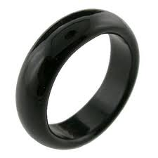
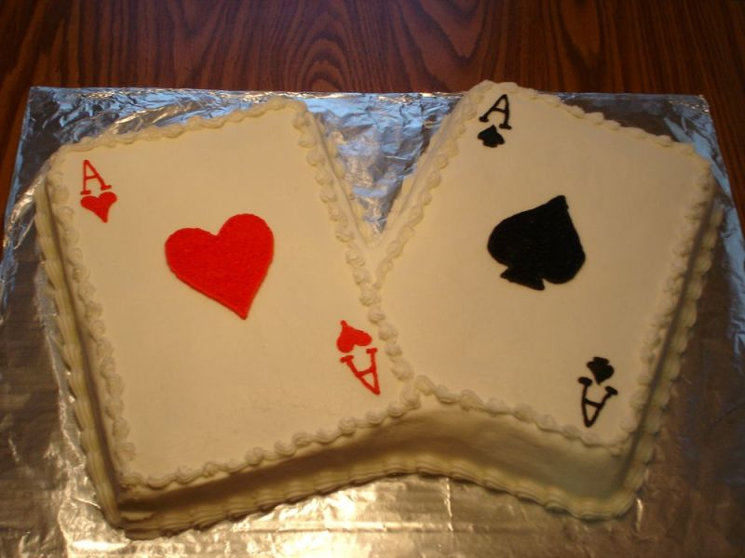

Other Symbols
AVEN Triangle
Black Ring
Ace of Hearts
Ace of Spades
Cake

Slide 30
Credits
The Asexual Visibility and Education Network
Asexuality.org

Slide 31
Q&A
What questions do you have
about Asexuality?

