Slide 1
INFORMER
JOB AID
#1
Instructions for requesting access
Link to start

Slide 2
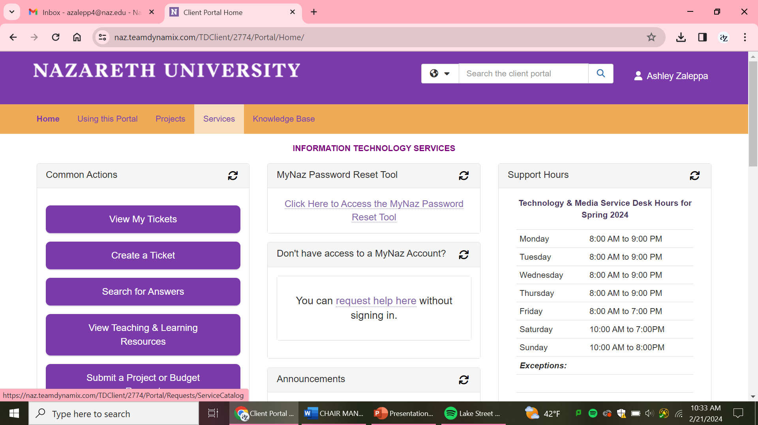
Click on Services

Slide 3
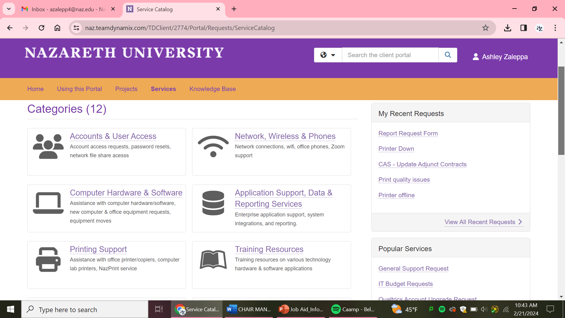

Slide 4
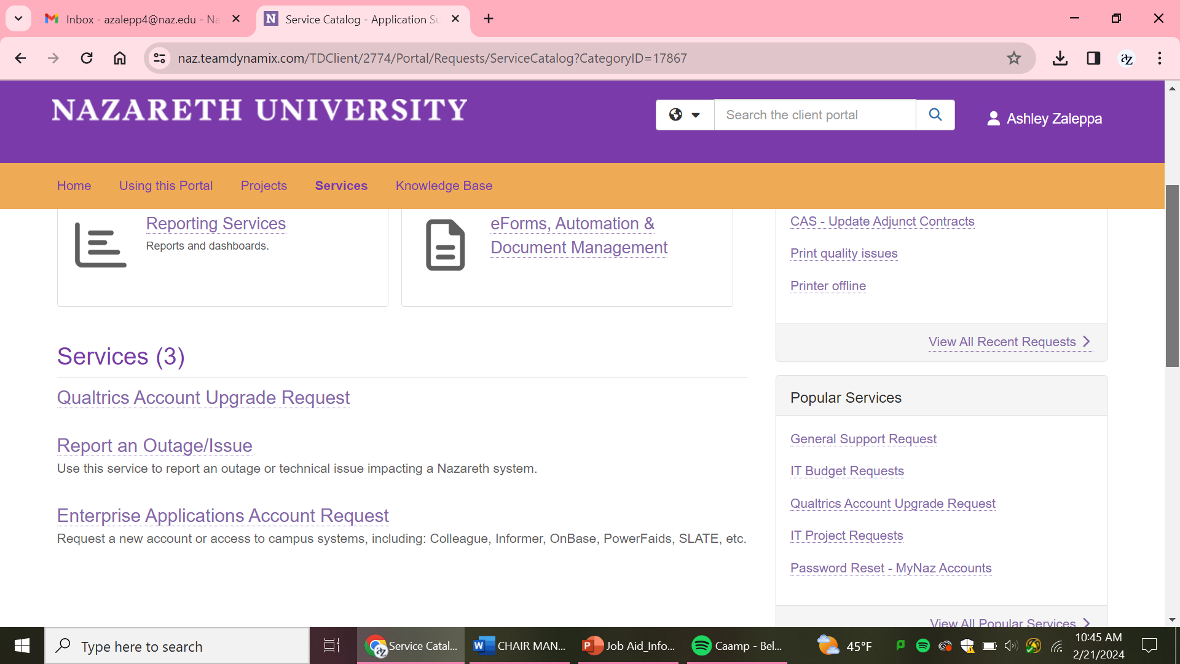
Scroll to bottom

Slide 5
