Slide 1
Core 2013

Slide 2
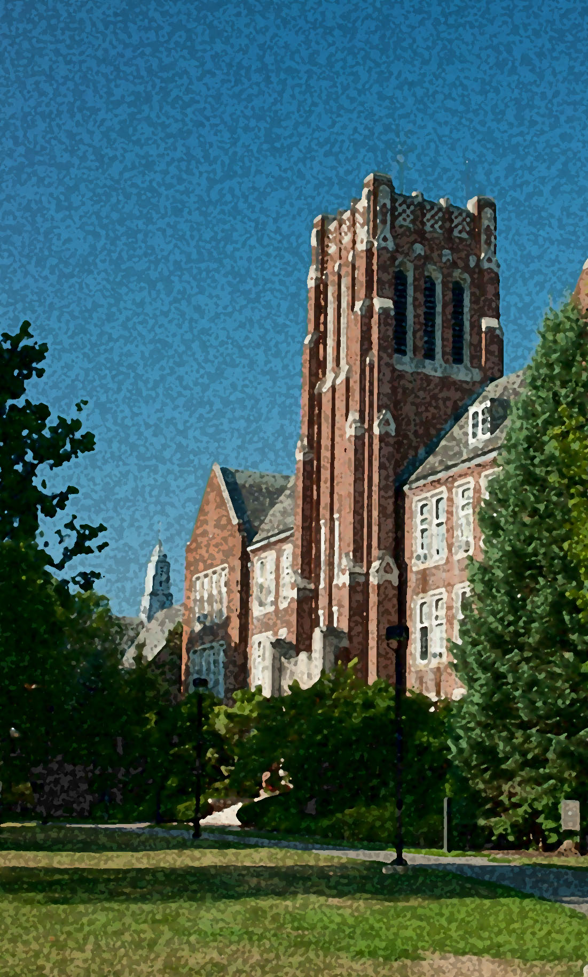
Core Manual
 Core Website
This is the Core Manual for faculty and students!
Visit: www.naz.edu/core

Slide 3
Overview of Core 2013

Slide 4
Portfolio @ Naz
 Abbreviation: P@N
 In each Core course/activity (FYS, ACS, P-EQ, IS course, EL) students upload an artifact into P@N
 When they engage in the Core Milestone Experience (CME), students formally reflect on these artifacts in relation to the particular question they have chosen to explore in their Integrative Studies

Slide 5
Academic & College Success
 Course Number: ACS 101
 Gives students the chance to learn about and discuss transitional aspects of college life (self exploration, study skills, personal responsibility and decision making) and explore ways of making the most of college
 Required for first-time freshmen in the first semester. (Transfer students take a Core and Portfolio Orientation Workshop instead.)
 1 credit

Slide 6
College Writing
 ENGW101 and ENGW102 or equivalent
 2 semesters, 6 credits

Slide 7
Modern Foreign Language
 Required for:
All BA programs
Some BS and MUSB programs, including those combined with teacher certification
 2 semesters of the same language, 6 credits

Slide 8
Perspectives-Enduring Questions Courses
 Abbreviation: P-EQ
 Introduce students to ways of thinking and knowing in each of the Perspectives areas
 Explore one or more enduring question(s) in each P-EQ
 Employ writing-to-learn strategies
 Include significant global or cultural content
 Students will upload one or more artifact(s) from each P-EQ course to P@N

Slide 9
P-EQ Courses
Continued
 One P-EQ in each of the 8 areas is required
 Designated by .Q (i.e., RES.Q 101)
 One will be a First Year Seminar (.F)
 P-EQ courses may count towards major and core (i.e., A History major may count HIS.Q 205 American Republic I as a P-EQ in History and a major requirement.)
 25 credits (8 courses)

Slide 10
Perspectives-Enduring Questions Areas
 There are eight P-EQ areas:
History
Literature
Mathematics
Philosophy
Religious Studies
Natural Science with laboratory
Social Science (Anthropology, Economics, Geography, Political Science, Psychology, Sociology)
Visual and Performing Arts (Art, Music, Theatre Arts)

Slide 11
First Year Seminar
 Abbreviation: FYS
 Perspectives-Enduring Questions course designated specifically for freshmen
 Engages freshmen in college-level learning and the Core
 Counts as both FYS and P-EQ
 Designated by .F (i.e., MTH.F102)
 Required for first-time freshmen
 3 credits

Slide 12
Integrative Studies
 Abbreviation: IS
 Provide depth of knowledge through exploration of a particular question of interest
 Characterized by :
student choice (no departmental mandates)
student responsibility (demonstrate integration)
opportunity for reflection
 3 courses that are thematically connected, 9 credits
200 level or higher
At most one from the major (prefix)
P-EQs may not count as IS courses

Slide 13
IS Courses
Continued
 Students may come up with their own set of three related courses or draw from the IS clusters and IS themes that are listed on the Core website
 Workshops will be offered each semester to assist students in selecting a set of IS courses
 Students upload at least one artifact to P@N from each potential IS course they take
 When students reach the Core Milestone Experience, they identify their IS courses and name the cluster/theme

Slide 14
Experiential Learning
 Abbreviation: EL
 Students must complete one or more approved Experiential Learning Pathways:
Course-based service learning
Student leadership
Internships
Co-curricular service
Educational Field Hours, Student Teaching, Practica & Clinicals
Study Abroad
Undergraduate Creative Activity, Research & Scholarship (CARS)
 All ELPs follow NSEE best practices for experiential learning
 Credit-bearing or non-credit-bearing

Slide 15
EL
Continued
 Students will upload a reflection (and possibly an artifact) from each EL to P@N
 Ideally, students will integrate what they learned from their EL(s) with what they learned throughout the rest of the core
EL courses and non-credit bearing EL activities will be tracked in NazNet
Credit-bearing ELs are found on NazNet (under Search for Sections) by selecting the “EL” course attribute. Non-credit-bearing ELs are found on the Core website.

Slide 16
Health & Wellness
 Health and Wellness component included in ACS101
 1 Health and Wellness course/experience (0 credits)
includes PED but will also include other types of courses/experiences

Slide 17
Core Milestone Experience
 Abbreviation: CME
 An opportunity for students to think about and integrate their learning
 Students formally reflect on their P-EQ, IS and EL artifacts with respect to their intellectual journey related to their particular question
 Taken during or after the 3rd IS course and, ideally, after the EL and Health/Wellness have been completed
 Ideally, taken prior to the final semester
 1 course, 0 credits

Slide 18
CME
Continued
 In the CME, students will…
Formally choose the name for their Integrative Studies
State explicitly how their chosen set of courses furthers engagement with their particular question.
Relate their particular question to larger Enduring Questions, their P-EQ courses, their EL, Health & Wellness and their major.
Create something (essay, video, performance, artwork, etc.) that clearly communicates the above.
Archive the work in P@N and share it with others in the CME course.

Slide 19
Which Core?
 To whom does the 2013 Core apply?
All new freshmen (including transfer freshmen, or TFs) in fall 2013 and beyond
All new transfers entering in fall 2015 and beyond

Slide 20
Which Core?
Continued
 How will I know which Core a student is following?
1988 Core
- Green advising folders
- Red folders for INCH
- Catalog years prior to 2013 and catalog years ending in an X (i.e., 2013X, 2014X)
2013 Core
- Blue advising folders
- Purple folders for INCH
- Catalog years 2013 and beyond (without an X)

Slide 21
Transfers Entering with a Degree
 Transfer students entering with an AA or AS degree:
First Year Seminar and ACS101 are waived
Core and Portfolio OrientationWorkshop is required
At least 2 P-EQs must be completed at Nazareth
The Core Milestone Experience (CME) must be completed at Nazareth
 NOTE: All transfers must complete 6 credits of College Writing. Transfers with a degree no longer get a waiver for one writing course.

Slide 22
Residency Requirement
 The college requires every UG student to complete a minimum of 30 undergraduate hours of study at Nazareth College as a matriculated student.
 At least 4 P-EQs must be taken at Nazareth for students entering as freshmen. At least 2 P-EQs must be taken at Nazareth College for transfer students.

Slide 23
Degree Requirements
 Students still need to complete a minimum of 120 credits to earn a bachelor’s degree
 Students still need to complete the minimum number of liberal arts credits required for their degree type:
B.A. degree requires 90 liberal arts credits
B.S. degree requires 60 liberal arts credits
MUS.B degree requires 45 liberal arts credits
B.F.A. degree requires 30 liberal arts credits

Slide 24
Questions?
Visit the Core 2013 Website

