Slide 1
Ethical Use of Nazareth Data and Technology
T@N 2012
January 11, 2012
Olga Lapczak

Slide 2
What does “Ethical” mean?

Slide 3
What does “ethical” mean?
Data integrity / accuracy
Data security

Slide 4
Data Integrity / Accuracy
Shared data
Reporting requirements
Data–based decision making

Slide 5
Data Accuracy – what could go wrong?
What are some of the consequences of bad data?
Lower number of applications
Fewer new and returning students
Federal sanctions and penalties
Fewer or smaller donations
Law suits

Slide 6
Data Accuracy – what could go wrong

Slide 7
Shared data – you are not alone
Data drives many of the operations around campus.
Many departments share common objectives utilizing this data. e.g. the departments of Enrollment, Registrar, Financial Aid, Student Accounts and Res Life are all involved in enrolling a new student.
Codes and tables are shared. e.g. the DEPTS file
Practically all departments rely on demographic info

Slide 8
Shared Data – who’s in charge?
Data regarding students eventually flows from the Enrollment department to all other departments on campus.
Who owns the data?
How many offices / people enter or change the records?

Slide 9
Example: What is Student Data/ Educational Record?
Tells us who the student is. (Personal Information, Name, Age, SSN, etc.)
Describes the student’s past & present. (ACT score, grades, major, etc.)
Indicates what Nazareth offers. (degree plan, schedule, etc.)
Records financial transactions. (financial aid, parent income, billing, payments, etc)
Both manual entry and automated feeds.

Slide 10
Who Utilizes Student Data?
Students
Faculty
Staff
Nazareth administration
Alumni
Government agencies/ accrediting bodies / vendors
Other colleges/universities
Impact of Bad Data: Inconvenience to the student, poor decisions, time lost correcting, broken trust

Slide 11
STUDENTS File – it is not alone

Slide 12
STUDENT ACAD CRED File

Slide 13
Reporting Requirements
Federal :
Wage Theft Prevention Act
IPEDS
IRS
W2
Financial Aid
State
Financial
And there’s a lot more

Slide 14
Nazareth Application Data Flow Diagram
Inigral
(facebook)
COLLEGE BOARD
CPS (edconnect)
#6 – CSS profiles
PowerFAIDS
#11 – ISIRs
#3 AP
scores
NYS Hesc
#15 –
TAP
awards
#10 – DL
& Private
loans
COMMON
aPP (FR)
#16 – Accepted Students
#1 PSAT
scores
Cod (edconnect)
#2 SAT
scores
#43 – STU
Roster
#9 – PELL
grants
Tr, Gr, & FR
apps
#7 – Awards
& Disbs
#8 –
ADM
#14 --
CWS
#12 – STU
REG
#4 FR appls
Colleague
#13 – SAP
Teach
(edconnect)
#5 – appl’s
Real time
informer
Python
(gmail)
ODS
#42 – Various Colleague Tables
IR
ipeds
#17 – student email
#41 – CA dashboard
Ca data_marts
imodules
acs
#18 – alumni data
#40 – STU tuition info (1098’s)
3n
#19 – Emergency Notification
#39 – Accts Payable (1099’s)
irs
#20 – Stu
registrations
#37 – INTL STU info
Gov’t
(sevis)
#27 – W2 info
irs
naznet
Real time
Active
directory
#21 – FAC, STAFF,
STU ids
#36 – STU ids
Sentinel
#22 – STU, CLASS info
#34 – STU ids
#31 – financial
#35 – STU ids
#23 – STU, CLASS info
Lib
FRx
Security
Escort
Ad astra
#33 – STU
meal plans
#24 – CLASS schedule
#30 – Payroll recon
Blackboard
transact
#25 – Vet
info
#38 – course
catalog
#28 – time
reporting
moodle
#26 – rqsts for
transcripts
#29 – payroll
#32 – Open positions
HEOP
(NYS)
acalog
Attend
Enter-
prise
Financial
institutions
People
admin
ecard
VA Once
Nat’l Clearinghouse

Slide 15
Data-Based Decision Making
Rolling out Business Objects reporting tool
Institutional Research reports
Year to year comparisons
Trend analysis
Projections
Dashboards
And there’s a lot more

Slide 16
So what are we doing to help?
Data Standards Entry:
Colleague training for new employees
Data Standards Maintenance:
Data Custodian diagram
Data Standards Documentation
Ongoing training
Data Standards Integrity
Data Checking

Slide 17
Data Security

Slide 18
Data Security
Reputation
Security Best Practices
Legal obligation to protect data

Slide 19
Protecting the Data
To start, let us think about the things currently happening in our world:
Security breaches are happening almost every day.
Reputation is the first thing to be impacted when a breach occurs.
States are reacting to public outcry by passing laws for more stringent and proactive security measures.
Stress increases on already stretched compliance resources.
The cost of recovering from a breach will be expensive.

Slide 20
Data Security – it’s all about the desktop
“Since 2008, higher education institutions have experienced a staggering 158 data breaches resulting in over 2.3 million reported records compromised. In 2009 alone there were 57 reported data breaches, and year to date through July of 2010, there have already been 32 breaches.
Considering that most breaches are not reported until well after the fact, 2010 is on pace to surpass the 2009 breach totals. So the question is: Are higher education institutions familiarizing themselves with the threats and regulations, and costs associated with protecting sensitive data? And are they being as diligent as necessary to protect that data? “ Alex Rothacker

Slide 21
Data breaches at educational institutions
http://www.adamdodge.com/esi/

Slide 22
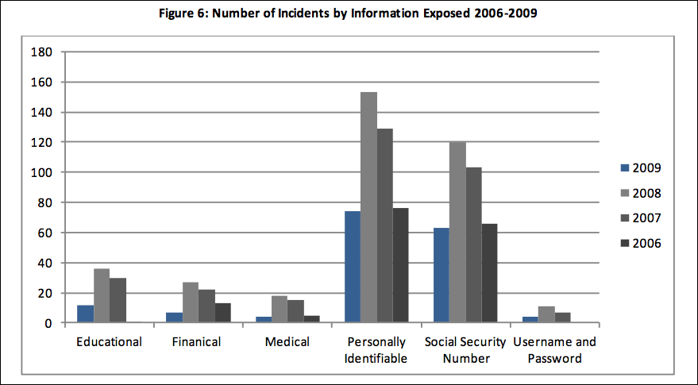
Data breaches at educational institutions
[Financial]
http://www.adamdodge.com/esi/

Slide 23
The Edelman Trust Barometer
This annual survey conducted by the world’s largest public relations firm specifically addresses what consumers will do when there is no trust. 77% of the U.S. respondents said they would refuse to buy products or services from a company they do not trust.
Security is never going to be 100% reliable. No matter how much money you spend, “they” can get in. If that’s the case, it’s possible the public may give you some sympathy. The public is less forgiving when they find out that the breach was caused by carelessness or plain stupidity.
Notes:
Core Mission Values and Guiding Principles
Catholicity: We treasure and build on our strong Catholic identity in relationship with the Diocese of Davenport. As an independent institution of higher learning, St. Ambrose University embodies our faith tradition through teaching, learning, scholarship, and service, through openness to those of other faith traditions, and through the pursuit of justice and peace.
Integrity: We believe that as individuals we are capable of living in the fullest measure when our lives are freely based on values that acknowledge a loving God and a life-affirming moral code. Therefore, we teach, learn, and work in a climate of mutual respect, honesty, and integrity where excellence and academic freedom are cherished.
The Liberal Arts: We are committed to the richness of the liberal arts tradition through quality instruction that fosters development of a broad awareness of humanity in all its dimensions. Ambrosians use their knowledge, talents, and career skills in service to others.
Life-long Learning: We believe that people at all stages of life need educational opportunities. Therefore, we offer learning programs with student-centered teaching that lead to baccalaureate and professional graduate degrees in curricula through the doctoral level as well as non-degree offerings at the undergraduate and graduate levels. To meet the needs of our diverse student body, we use a variety of delivery systems and formats in the Diocese of Davenport, the State of Iowa, and other authorized locations. We collaborate with other organizations to offer further opportunities around the world.
Diversity: We believe in the inherent God-given dignity and worth of every person. Therefore, we strive to develop an understanding of human cultures, achievements, capabilities, and limitations to promote justice and peace and use our talents in service to others and the world. We welcome people from other countries and cultures to study, learn, and work at St. Ambrose. Likewise, we encourage Ambrosians to teach, learn, engage in scholarship, and serve abroad.

Slide 24
So Why Is All of This Important . . . . to me? User responsibility within the College is the cornerstone upon which security practices are built.

Slide 26
The computer was inside a briefcase in the locked automobile of a Tulane employee who was travelling outside New Orleans…
The employee had been processing tax records during the holiday break…

Slide 27
Reported at http://www.adamdodge.com/esi/

Slide 28
People as the Perimeter Security is everyone's business.

Slide 29
Six Workplace Best Practices
Keep data secure
DATA HANDLING: Do not send confidential information in plain text e-mails.
DATA STORAGE AND SHARING: Never save sensitive data on a laptop’s C: drive or on a flash drive.
SECURITY AT YOUR DESK: When you leave your desk, lock your computer or log off.
CREDIT CARD, CASH, CHECK: Secure check and credit card transaction information.
PASSWORDS: No one should ever know your password. Change it every 90 days.
CONFIDENTIAL DATA: Learn what data is considered confidential.

Slide 30
What is “Confidential” information?
PII
Personally Identifiable Information
Defined by law (more in a minute)
CI
Confidential Information
Defined by local custom / practice
Data Custodian
The specific person responsible for collecting, maintaining and safeguarding specific pieces of PII or CI

Slide 31
United States Government Accountability Office :
PII is: “…information that can be used to locate or identify an individual, such as names, aliases, Social Security numbers, biometric records, and other personal information that is linked or linkable to an individual. Loss of such information may lead to identity theft (the wrongful obtaining and using of another person’s identifying information in some way that involves fraud or deception, typically for economic gain) or other fraudulent use of the information, resulting in substantial harm, embarrassment, and inconvenience to individuals.”
http://www.gao.gov/new.items/d08343.pdf

Slide 32
Breach laws
Define PII and…
your responsibilities to safeguard PII
your requirements after a breach
Need to understand existing breach laws
Federal
State

Slide 33
Breach laws
State data breach law
Forty-six states, the District of Columbia, Puerto Rico and the Virgin Islands
Alabama, Kentucky, New Mexico, and South Dakota have no such laws (as of 10/12/2010)
National Conference of State Legislatures : http://www.ncsl.org/default.aspx?tabid=13489
Differ on
Definition of PII
Encryption
Safe haven
Deletion
Threshold for notification for breach
Each applies to their residents

Slide 34
New York State Breach Law
An individual’s unencrypted personal information* + 1 or more of the following:
- Social security #
- Driver’s license number or non-driver ID
- Account number, credit or debit card # + security code, access code or password which permits access to an individual’s financial account
* any information concerning a natural person which, because of name, number, personal mark, or other identifier, can be used to identify such natural person
http://www.cscic.state.ny.us/lib/laws/faq.cfm

Slide 36
Over Simplified PII / CI policy (think SSN*)
If you’re not the data custodian don’t collect it
If you need it ask for it
If you don’t need it you shouldn’t have it
If you do use it don’t store it (ask again)
If you must store it encrypt it / password protect it
If you do have it don’t share it (ask again)
If you have to share it send it securely
When you’re done with it securely delete it
*Current Nazareth policy already restricts access to SSN.

Slide 37
Information Security Group
Newly formed Nazareth group to establish an Information Security Program
Defining CI (Confidential Information) for Nazareth
Responsible for :
Defining an Information Security Policy
Choosing supporting technology to enforce Policy (e.g. IDFinder)
Establishing training and education

Slide 38
What is FERPA?
FERPA (Buckley Amendment) is a federal law that protects the confidentiality of student educational records. Under the act, the student has the right to access their educational records, the right to request corrections, and the ability to limit disclosure of this information.

Slide 39
Nazareth College Policies Regarding FERPA
FERPA guidelines restrict directory information that can be released by colleges and universities. Under FERPA, directory information may be released without written consent from the student unless the student signs a nondisclosure statement in the Registrar’s Office.
While FERPA allows for the release of a wider range of directory information, Nazareth College Registrar’s Office has adopted an internal policy to release only:
• Name • dates of attendance
• previous school attended • class
• major fields of study • graduation honors
• degrees conferred • date and place of birth
http://www.naz.edu/registrar/ferpa-policy/

Slide 40
Next steps
Data Integrity / Accuracy
Data Standards documentation
New employee training
Data Custodian
Data Security
Stricter student access
Tighter password policy
Auth tool
Development of Information Security Program:
Information Security Policy
New technology
Awareness / training

Slide 41
Data Integrity / Accuracy/ Security
Information Security: “The preservation of confidentiality, integrity and availability of information” (ISO/IEC 27032 )
Everyone who comes in contact with data is responsible for data accuracy and security because we are all impacted.
Remember, the data will outlive all of us.

