Slide 1
Assessment Reboot
January 31, 2014
GAC 38

Slide 2
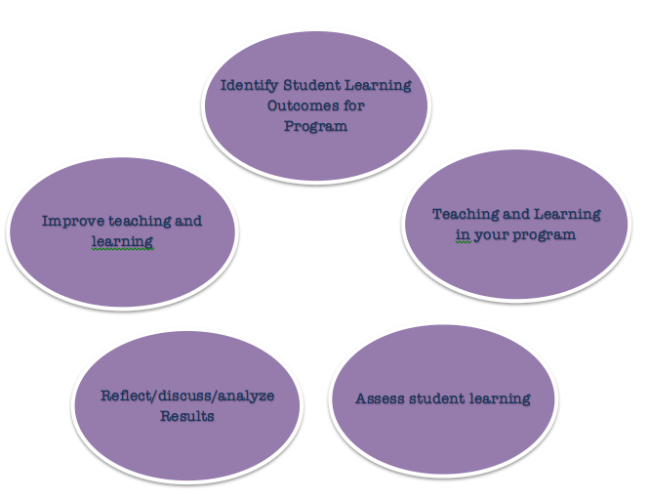
Review of Assessment Cycle
Documenting & Reporting

Slide 3
SLOs
College Level
Division Level (CAS, EDU, HHS, MGT)
Program Level
Course Level

Slide 4
Draft Naz SLOs
Graduates of Nazareth College will be able to…
“Use the modes of inquiry of the liberal arts and sciences to discover and develop personal and philosophical/intellectual, ethical, spiritual and aesthetic values”

Slide 5
Draft Naz SLOs
Nazareth College graduates will be able to…
“demonstrate intellectual adaptability, flexibility, and critical thinking that can be applied to the fundamental knowledge of their respective degree program”

Slide 6
Draft Naz SLOs
Graduates of Nazareth College will be able to…
“successfully transition from student to professional and meet the demands of their selected discipline”

Slide 7
Draft Naz SLOs
Nazareth College graduates will be able to…
“participate as an engaged member of the local and global community, professionally and civically”

Slide 8
Types of Evidence
Direct: evaluation of student learning by faculty
Indirect: perceptions of student learning by student

Slide 9
Direct evidence can be…
Papers
Test scores or test questions
Course assignments
Portfolio sections or whole portfolio
Faculty discussion of student learning in department/program meeting

Slide 10
Indirect evidence can be…
Surveys
Interviews
Focus groups

Slide 11
Discuss Results
What does the evidence mean?
Are students able to meet and exceed your expected outcomes?
What areas do students need more coverage, support, etc. do your students need?

Slide 12
Improve Teaching & Learning
Revising SLOs to more accurately represent what skills, knowledge, etc. your program values in a graduate
Revising curriculum: course content, sequence, readings
Professional development: a faculty reading circle, attend workshop, etc.

Slide 13
Reporting
We need ways to document the wonderful work that you do with your students in order to:
Make visible the teaching and learning for students and parents
Report program assessment cycle to college and wider community
Satisfy accreditation requirements

Slide 14
Can Assessment Be Meaningful & Easy?
YES…
One model moving forward:
Review SLOs
Use an indirect measure (question on program course eval, IDEA, survey)
Hold end of year program retreat where all program faculty discuss student work- areas that could use improvement related back to SLOs
Document this discussion (invite an Assessment GA or coordinator to the retreat to take notes)

